Slide 1
Year 5: Living things and their habitats
This topic overview is based on the PLAN knowledge matrix (for England). Please use link:
https://www.planassessment.com/living-things-y5
The matrix includes:
National Curriculum learning objectives
Key learning
Key vocabulary
Common misconceptions
Possible activities & evidence
Topic overview for teachers
Age 9-10

Slide 2
Year 5 – Living things and their habitats
Topic | Key Learning | page
An introduction to asexual and sexual reproduction in plants | Plants reproduce both asexually and sexually. Bulbs, tubers, runners and plantlets are examples of asexual plant reproduction which involves only one parent. Seeds are formed as part of sexual plant reproduction and are often held in fruits. | 4
Pollination in flowering plants | Sexual plant reproduction occurs through pollination, usually involving wind or insects. There are male and female parts of a flower. The pollen is transferred from the male stamen to the female stigma during pollination. | 5
Seed dispersal in plants | Seeds are formed as part of sexual plant reproduction. Seeds need to be scattered so they can germinate away from the parent plant. This is called seed dispersal. | 6
2

Slide 3
Year 5 – Living things and their habitats
Topic | Key Learning | page
Comparing the life cycles of a range of animals | As part of their life cycle, plants and animals reproduce. Most animals reproduce sexually. This involves two parents where the sperm from the male fertilises the female egg. Some young undergo a further change before becoming adults (e.g. caterpillars to butterflies). This is called a metamorphosis. | 7
Comparing the gestation period of different mammals | Most animals reproduce sexually. This involves two parents where the sperm from the male fertilises the female egg. They produce offspring which grow into adults. Humans and most other mammals give birth to live young. The time between egg fertilisation and giving birth is called the gestation period. | 8
3

Slide 4
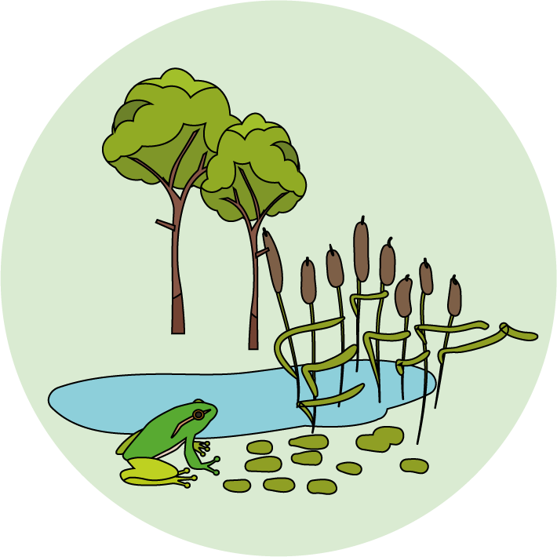
Living things and their habitats
Logo for section to sit inside roundel
Introduction to asexual and sexual reproduction in plants
Key Learning
Plants reproduce both asexually and sexually.
Bulbs, tubers, runners and plantlets are examples of asexual plant reproduction which involves only one parent.
Seeds are formed as part of sexual plant reproduction and are often held in fruits.
Activities and Websites
Exploring prior knowledge about plant life cycles.
https://explorify.wellcome.ac.uk/en/activities/whats-going-on/shooting-sprouts/classroom?view-type=public
Discussing sexual reproduction.
https://www.bbc.co.uk/bitesize/topics/zgssgk7/articles/zyv3jty
Looking at asexual reproduction.
Investigating seeds in some foods we eat.
https://www.bbc.co.uk/bitesize/clips/zvypyrd
Optional activities: Investigating seed patterns or growing plants from cuttings.
I can…
explain the difference between sexual and asexual reproduction and give examples of how plants reproduce in both ways.
identify a variety of fruits we eat and compare their seeds.
4

Slide 5
Living things and their habitats
Logo for section to sit inside roundel
Pollination in flowering plants
Key Learning
Sexual plant reproduction occurs through pollination, usually involving wind or insects.
There are male and female parts of a flower. The pollen is transferred from the male stamen to the female stigma during pollination.
Activities and websites
Exploring prior knowledge and finding out about wind pollination.
https://www.bbc.co.uk/programmes/p00lx94l
https://www.bbc.co.uk/programmes/p006997b
Comparing wind and insect pollination.
https://www.bbc.co.uk/bitesize/clips/zmrb4wx
https://www.bbc.co.uk/bitesize/clips/zfx76sg
Investigating insect pollinated flowers (two options for practical activities).
Further optional activity to find out about some unusual flower pollinators.
I can…
explain how flowering plants are pollinated in different ways.
identify the different parts of a flower which are involved in pollination.
5

Slide 6
Living things and their habitats
Logo for section to sit inside roundel
Seed dispersal in plants
Key Learning
Seeds are formed as part of sexual plant reproduction.
Seeds need to be scattered so they can germinate away from the parent plant. This is called seed dispersal.
Activities and websites
Reviewing prior knowledge and discussing seed dispersal as part of a plant’s life cycle.
https://www.bbc.co.uk/programmes/p00lxwk5
https://www.bbc.co.uk/bitesize/clips/zs9c87h
Comparing different ways plants disperse their seeds.
https://www.bbc.co.uk/programmes/p00lxv9z
https://www.bbc.co.uk/programmes/p00lxw4t
Investigating a seed helicopter design.
Additional optional activity on some more unusual ways seeds are dispersed by animals.
I can…
explain how the seeds of plants are dispersed in different ways.
investigate a model for seed dispersal.
6

Slide 7
Livings things and their habitats
Logo for section to sit inside roundel
Comparing the life cycles of a range of animals
Key Learning
As part of their life cycle, plants and animals reproduce.
Most animals reproduce sexually. This involves two parents where the sperm from the male fertilises the female egg.
Some young undergo a further change before becoming adults (e.g. caterpillars to butterflies). This is called a metamorphosis.
Activities and websites
Reviewing prior knowledge about animal reproduction.
https://www.bbc.co.uk/bitesize/clips/zp62tfr
https://www.bbc.co.uk/bitesize/clips/zdfpyrd
https://www.bbc.co.uk/bitesize/topics/zgssgk7/articles/z9xb39q
Comparing the life cycle of an amphibian, an insect and a bird. Making a fact file.
https://www.bbc.co.uk/teach/class-clips-video/science-ks2--ks3-the-life-cycles-of-different-organisms/zvh8qp3
frog: https://www.dkfindout.com/uk/animals-and-nature/amphibians/life-cycle-frog/
butterfly: https://www.dkfindout.com/uk/animals-and-nature/insects/butterfly-life-cycle/
Additional optional activity to compare a wider range of animal life cycles.
I can…
use secondary sources to find out about the life cycles of animals.
describe some differences between the life cycles of different animals.
7

Slide 8
Livings things and their habitats
Logo for section to sit inside roundel
Comparing the gestation period of different mammals
Key Learning
Most animals reproduce sexually. This involves two parents where the sperm from the male fertilises the female egg. They produce offspring which grow into adults.
Humans and most other mammals give birth to live young.
The time between egg fertilisation and giving birth is called the gestation period.
Activities and websites
Reviewing prior knowledge about the life cycle of mammals.
https://www.bbc.co.uk/bitesize/clips/zpmqxnb
Introducing the term ‘gestation period’.
https://www.dkfindout.com/uk/animals-and-nature/mammals/mammals-and-their-young/
Comparing the gestation period of different mammals and looking for patterns. Plotting a bar chart.
Additional optional activity to find out about some mammals with more unusual life cycles (marsupials and monotremes).
I can…
compare the gestation period for different mammals and look for patterns.
8

